Slide 1

Catholic Habits of Mind
Thinking with Faith, Thinking Philosophically; and Seeking and Valuing the Transcendent.
Denise Donohue Ed.D.
V.P. for Educator Resources and Evaluation
The Cardinal Newman Society
Patrick Reilly, Founder and President
The Cardinal Newman Society

Slide 2

Meeting Objectives
Participants will know with confidence that there are habits of mind stemming from the Catholic intellectual tradition and that these habits can be used and fostered in the classroom.

Slide 3



Specific Objectives
How to foster thinking with faith in content areas.
How to foster thinking philosophically in content areas.
How to foster seeking and valuing the transcendent in content areas.

Slide 4

Application of Knowledge
Participants will be able to apply the habits of mind to sample standards.

Slide 5

Virtues are necessary to attain Heaven
Notes:
Catholic Habits of Mind focus on the elicitation and incorporation of virtuous habits of the intellect to aid students in human flourishing and facilitate a pathway to Heaven. A habit is a stable disposition that inclines a person to act in a certain way. It is often attained with practice. Often, we think of the development of virtuous habits as focusing on only moral and spiritual qualities, but all the virtues are important to address in the education of children because the purpose of Catholic education is to integrally form the student in mind, body, and soul so that they might first know and love God and second to serve their fellow man. These faculties of the human person should be developed harmoniously, with morality and ethics in line with knowledge and understanding and the development of one’s physical capacities.
Jesus taught in the Beatitudes the result of acquiring specific virtues allows us to gain entrance into the eternal Kingdom: “Blessed are the poor in spirit, for theirs is the kingdom of heaven…Blessed are the pure of heart, for they shall see God.” Catholic education is all about forming our students – and ourselves – in virtue, since virtue is the bedrock on the pathway to Heaven.

Slide 6
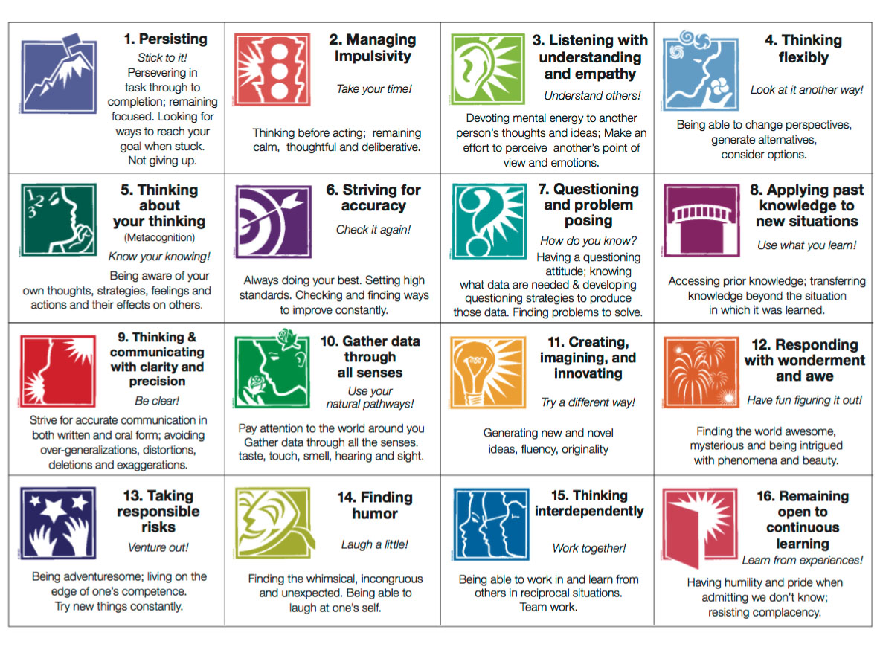
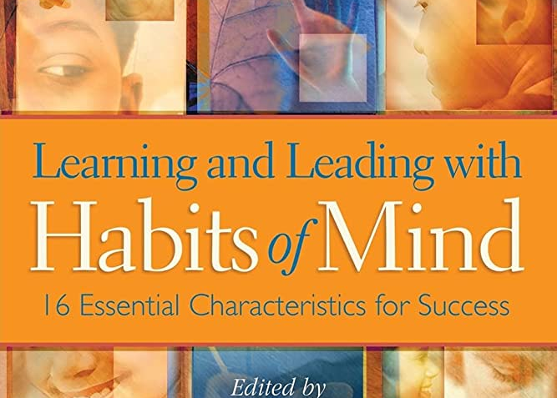
Secular Habits of Mind Program
Notes:
Secular education has developed programs situated around the eliciting and forming of virtuous behavior from students. While these secular programs have some utility in schools – who wouldn’t want to teach students to learn to gather data through all their senses, or think flexibly, or find humor – a Catholic education aims for much more, by showing how even these productive actions have an ethical dimension. And not only does Catholic education focus on the moral and ethical dimension, the hallmark of Catholic education, is the search of truth. And this search for truth ultimately leads to Truth Himself: God. This is a path that secular education cannot pursue. Our nature is designed to pursue truth through the inquiry of things. When illuminated by God’s grace, we understand and determine the interconnection of things, and learn something about the higher causes of things.
This is because we haven’t sequestered faith to the gulag - but joyfully embrace it for what it is, a gift from God.

Slide 7

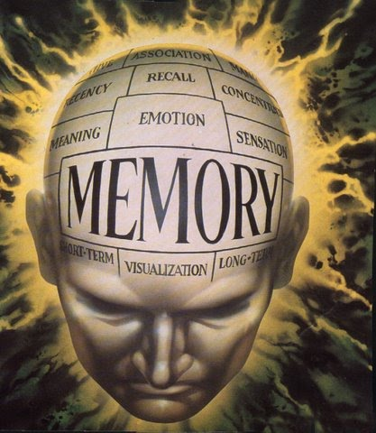
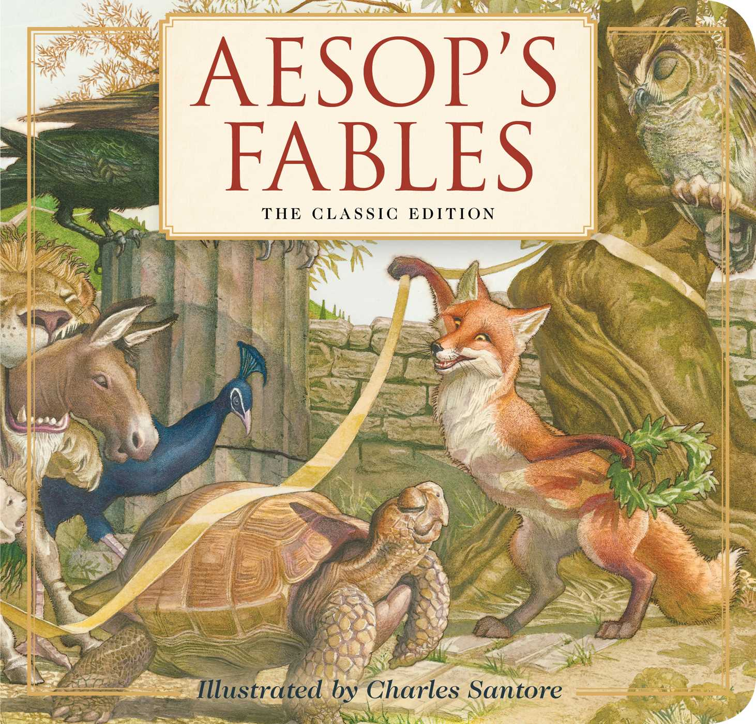
Cognitive habits
Memory and Imagination
Notes:
The ancient Greeks discussed the need for the development of virtue in order to live a good life. Catholic Intellectual virtues involve cognitive habits which encompass the internal sensory powers of Memory and Imagination. We must help students develop these internal sense powers so that they can activate BOTH intellectual and moral virtues, because these go hand in hand. Memory is essential to the development of habits. Without memory there is no habit at all. Memory gives us facility and can influence imagination. The strengthening of memory through recitation of all types of material, or repeated practice of desired actions, aids in habituation.
We can help students cultivate their imagination through the use of analogy, similes, and metaphors. It’s wonderful to see a child apply a story from Aesop’s fables, which we all know deals with various plights of animals, to the real world and even to their self. I heard someone say that children don’t have the capacity of extending their imagination, let alone their moral imagination. I thought, that’s a person who doesn’t know my son! (Joseph and going to the Doctor to get a shot.)
The Catholic intellectual tradition – developed by St. Augustine, St. Thomas Aquinas, and many others – distinguishes intellectual virtues into two categories: the Practical Habits and the Speculative Habits.

Slide 8


Practical Habits
Art
Prudence
Notes:
But first we need to look at why we attain knowledge. We attain knowledge for two ends; for the practical purposes of making and doing things and for contemplation, or the attaining of knowledge for its own sake.
In the classical tradition of intellectual virtues, the practical habits we elicit from students are called art and prudence.
art – art directs the intellect in the application of certain rules or methods to make things that are useful, practical, beautiful, and pleasing. It is the capacity of knowing how to do something or knowing different techniques of how to do something, such as knowing how to use a computer program, how to make a kite fly, how to give a good speech and even the art of apologetics. Art involves applying knowledge to shape matter, whether that matter is an artistic sculpture or principles of arithmetic or logic. (Application of learned skill – cognitive and physical)
b) prudence - directs the intellectual powers toward knowing what is best and assessing what ought to be done. It involves analyzing and evaluating the proper means of action with the direction of contributing to our long-term happiness and is the foundational intellectual virtue necessary for all the other moral virtues. According to St. Thomas, prudence is the “form” of the moral virtues, and the human passions [will] and actions [what we physically do] are the “matter.” Thus, in any particular situation, “it is prudence that determines what the just, temperate and brave act is.”
St. Thomas Aquinas, De veritate 27, 5 ad 5.
Sr. Teresa Auer, O.P., Called to Happiness: Guiding Ethical Principles (Third ed.) (Nashville, Tenn.: St. Cecilia Congregation, 2013), 163.

Slide 9
Speculative Habits
Understanding
Science
Wisdom
Notes:
There are three Speculative (or Theoretical) Intellectual Habits which are concerned with the contemplation of Truth (which is a transcendental common to all human beings everywhere, across all time).
The first is:
Understanding – understanding is the cultivation of knowledge of first principles or truths that are self-evident or that reason and logic add to our experience. This knowledge is intuitive and easily attainable, such as the law that something cannot both exist and not exist at the same time under the same conditions. That man needs air to live. That the human body eventually dies.
The second is science: Science - uncovers “knowledge of conclusions acquired by demonstration through causes or principles which are final in one class or other.” Science therefore is the evident knowledge of something through demonstration, but much more, it is human reason acting upon knowledge to draw conclusions from sound premises and thereby multiplying knowledge of creation, humanity, and God. It involves the habits of careful observation, experimentation, and measure in order to reach conclusions and involves demonstrative reasoning. Science demands evidence and properly ordered reasoning. This evidence and reasoning assist us with the determination of a certain level of certainty about a thing.
c) The third is wisdom: Wisdom is the knowledge of conclusions to life’s deepest questions. Its object is truth and is generally identified as the study of philosophy or metaphysics. It seeks the answers to the questions of humanity’s existence and that of the universe, such as, “Why is man the only rational creature?” or “Why are the planets ordered the way they are?” In Catholic education, we are called to facilitate discussion and to direct the student’s intellect toward grasping the relationship between humanity and these existential realities.
See Auer (2013) 156 for examples.
See Martin Augustine Waldron, “Virtue,” The Catholic Encyclopedia Vol. 15 (New York: Robert Appleton Company, 1912) at http://www.newadvent.org/cathen/15472a.htm (accessed on Oct. 23, 2020) for definitions of the intellectual virtues.

Slide 10
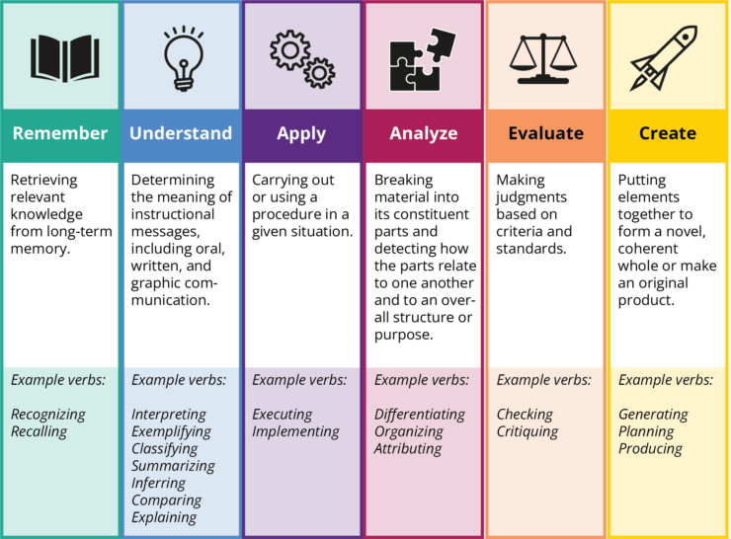
Memory Understanding Art Science Prudence Imagination WISDOM!!!
Notes:
Now let’s take a look at Anderson & Krathwohl’s Revised Bloom’s Cognitive Taxonomy (2001) and compare it to the classical intellectual virtues we just discussed.
We see that Memory and Imagination are on the two ends of their taxonomy and that understanding aligns with each presentation, Art is the application of cognition and physical capabilities and works with applying, science uses our ability to take first principles and the causes of things and to observe, experiment, measure and order things. Prudence is right reason in action and makes judgements and evaluate criteria and standards.
Look at where wisdom is!
Wisdom is the realm of our Catholic faith-based education! We teach to the transcendent in Catholic education and because we teach to the transcendent, we need “Catholic” Habits of Mind.

