Slide 1

Catholic Habits of Mind
Module 2
Thinking with Faith, Thinking Philosophically; and Seeking and Valuing the Transcendent.
Denise Donohue Ed.D.
V.P. for Educator Resources and Evaluation
The Cardinal Newman Society
Patrick Reilly, Founder and President
The Cardinal Newman Society

Slide 2
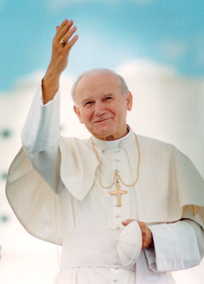
Thinking with Faith
With St. John Paul II
Notes:
I believe most of us know the document Fides et Ratio by St. John Paul II. Perhaps you haven’t read it recently, or at all, but it’s one of my favorite texts. To reclaim and honor the Catholic intellectual tradition, there are three Catholic habits of mind that we can champion as Catholic school teachers, and St. John Paul II helps us do just that in our first topic for discussion - forming students in the intellectual habit of thinking with faith.
In Fides et Ratio, St. John Paul II discusses the place of St. Thomas Aquinas in the Church’s tradition and specifically how St. Thomas promotes and defends the harmony between faith and reason. (43). We know of St. Thomas’ extensive use of philosophy and how he was able to bring about a deeper and richer understanding of divine revelation through its use in the Summa. He stated that since both the light of reason and the light of faith come from God, there could be no contradiction between them. Over seven centuries later we read the writings of St. John Paul II who further states “Faith therefore has no fear of reason, but seeks it out and has trust in it. Just as grace builds on nature and brings it to fulfillment, so faith builds upon and perfects reason.”

Slide 3

Faith is trust in what we can’t see..
Notes:
Students must be taught that faith is a valid way of knowing. This is quite opposed to the teaching in secular education today, where faith is dismissed, and the material sciences are held out as the highest and most privileged ways of knowing.
We, as teachers -and witnesses- have been tasked with the responsibility of awakening and deepening the faith in students.
We know that faith is the trust we have in something we can’t see. It is generally based on the authority and credibility of the sources, which usually involves a person or thing. An example of human faith is to believe that Alaska exists without ever having been there based on the credibility of others and their testimony. Certitude is not personally confirmed, but the will and the intellect join to assent to the truth that Alaska is a place based on the credibility and testimony of others.
Faith becomes supernatural when we are disposed to it through the sacraments and grace, and the matter is based on Divine Revelation from God Himself. Here the will and the intellect are turned toward God, the evidence being the witness of holy men and women, the prophets, the saints, the Apostles, and Jesus Christ.
By sharing our personal beliefs in God’s original plan for us as creatures of faith and providing examples of how faith and reason are complementary (for example my faith tells me that Jesus actually lived; it was when I saw his crib at St. Mary Major in Rome that these two things really hit home). We need to break through the secular messaging our students are receiving and help them see that faith has a very valid place in the discussion of identifying the truth of a thing.

Slide 4

We must develop our own faith first.
The Risk of Education
By Luigi Guisanni
Notes:
This reminds me of the text, The Risk of Education by Luigi Giussani. In the text Giussani states the importance of teachers (and parents) as credible witnesses to the faith, who impart the traditions (the values and meanings of things) based on a Catholic worldview, to young people as a hypothesis to either accept or reject through their reason and lived experience.
Giusanni reiterates what others before him have taught, that the transcendentals of truth, justice, happiness, beauty, and goodness are inherent as a longing in every human being, who having experienced them at least once desires to experience them again and tests the traditions against his questions and concerns. Guisanni states that these traditions must be tested by the student when he is confronted with life issues so that they can be accepted and assimilated into the student’s personal belief system. The risk of not testing the hypothesis, is threefold: hostility to Christianity, indifference, or a rigid and hostile traditionalism.
Guissani says to educate is to help someone understand the elements of reality… the ultimate meaning of things.
Of course, in order to present the tradition, one has to know the tradition first.

Slide 5

Saint John Henry Newman
Faith and Obedience are “the whole duty and work of the Christian” (P.S. ii, 153).
His righteousness has been “wrought out of sin, the result of a continual struggle – not spontaneous nature, but habitual self-command” (P.S. v, 210)
Notes:
And to lead us into what St. John Henry Newman said on developing a “philosophical habit of mind,” I want to briefly provide the insights he gives us about how to develop faith. Instead of focusing on the coherence of faith and reason Newman believed it’s the conscience that needs to be sensitized - to hear God’s inner voice within us. Newman taught that as human beings we are compelled to “obey God primarily because we actually feel His presence in our consciences bidding us [to] obey Him” (P.S. I, 20). And this is where the virtue of obedience is so important to Newman. Children must first be taught obedience to authority – their parents, other adults, their teachers, and to just laws – to learn obedience to God’s revealed laws and to the inner laws dictated within their hearts. He stated that “obedience leads to faith and then becomes its fruit and guarantee”. He also instructed that obedience is the test of faith. Think of Abraham our Father in Faith, and the Blessed Virgin Mary. He taught that the effect of a living faith brings about a share in the divine nature, and that this righteousness is “wrought out of sin, the result of a continual struggle – not spontaneous nature, but habitual self-command.”

Slide 6
Thinking Philosophically
With St. John Henry Newman

Slide 7
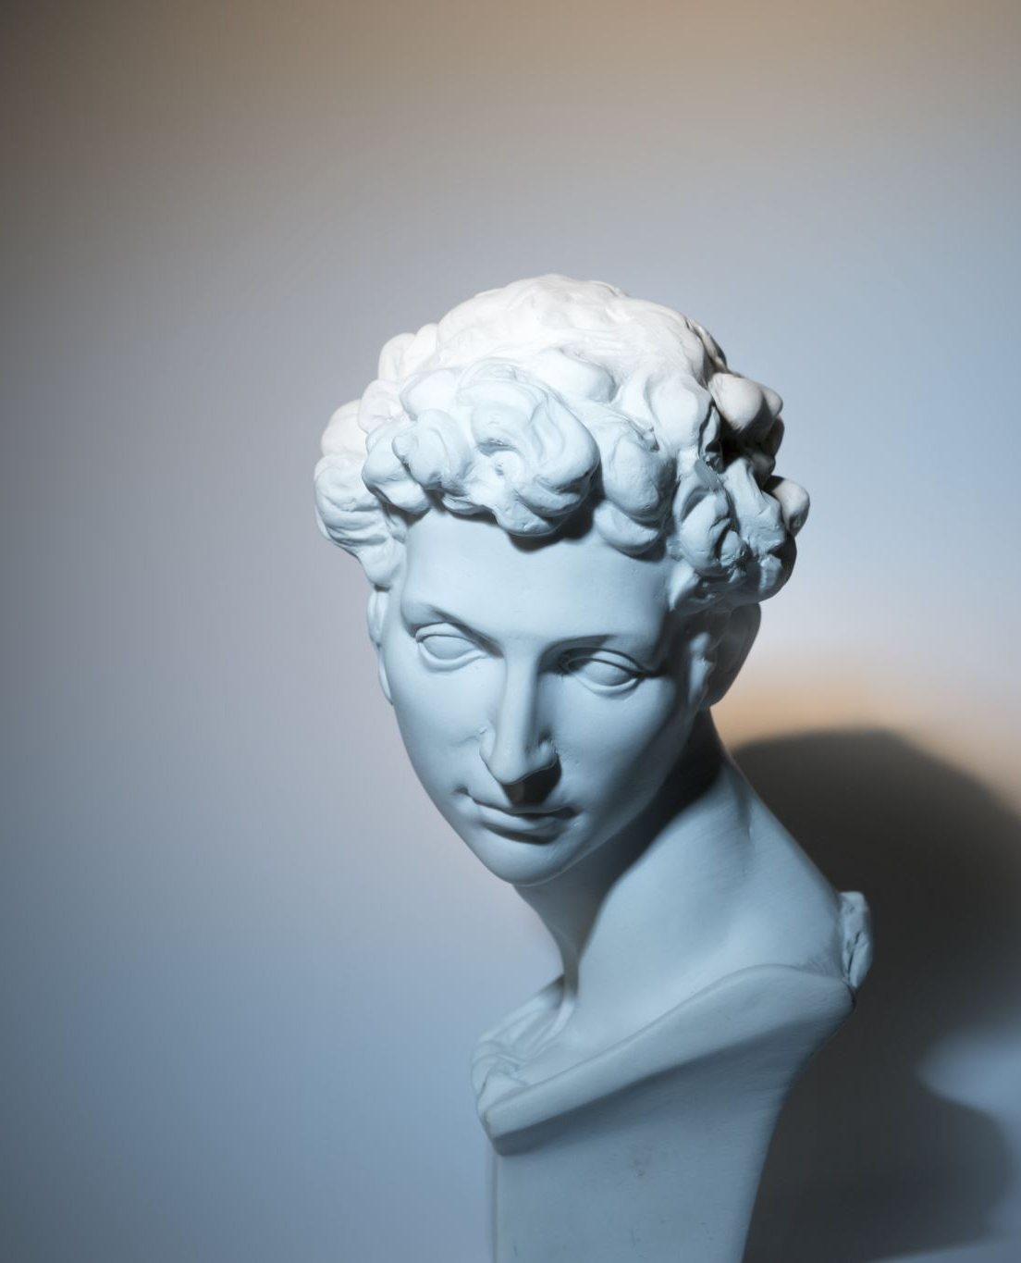
Socrates
“know thyself”
Aristotle
matter and form, accident and essence

Slide 8


Unity of knowledge
all reality united by origin in God, the Creator
all knowledge leads to God
branches of knowledge (arts, sciences)

Slide 9
Philosophical habit of mind
what are essences of things
how ideas relate to each other
how ideas can be organized
branches of knowledge
first principles of each discipline
habits and skills of reasoning

Slide 10
“I want a laity, not arrogant, not rash in speech, not disputatious, but [Catholics] who know their religion, who enter into it, who know just where they stand, who know what they hold and what they do not, who know their creed so well that they can give an account of it, who know so much of history that they can defend it. I want an intelligent, well-instructed laity…
“I wish you to enlarge your knowledge, to cultivate your reason, to get an insight into the relation of truth to truth, to learn to view things as they are, to understand how faith
and reason stand to each other, what are the bases and principles of Catholicism and where lies the main inconsistencies and absurdities of the Protestant theory.
“…You ought to be able to bring out what you feel and what you mean, as well as to feel and mean it; to expose to the comprehension of others the fictions and fallacies of your opponents; to explain the charges brought against the Church, to the satisfaction, not, indeed, of bigots, but [people] of sense, of whatever cast of opinion.”

Slide 11
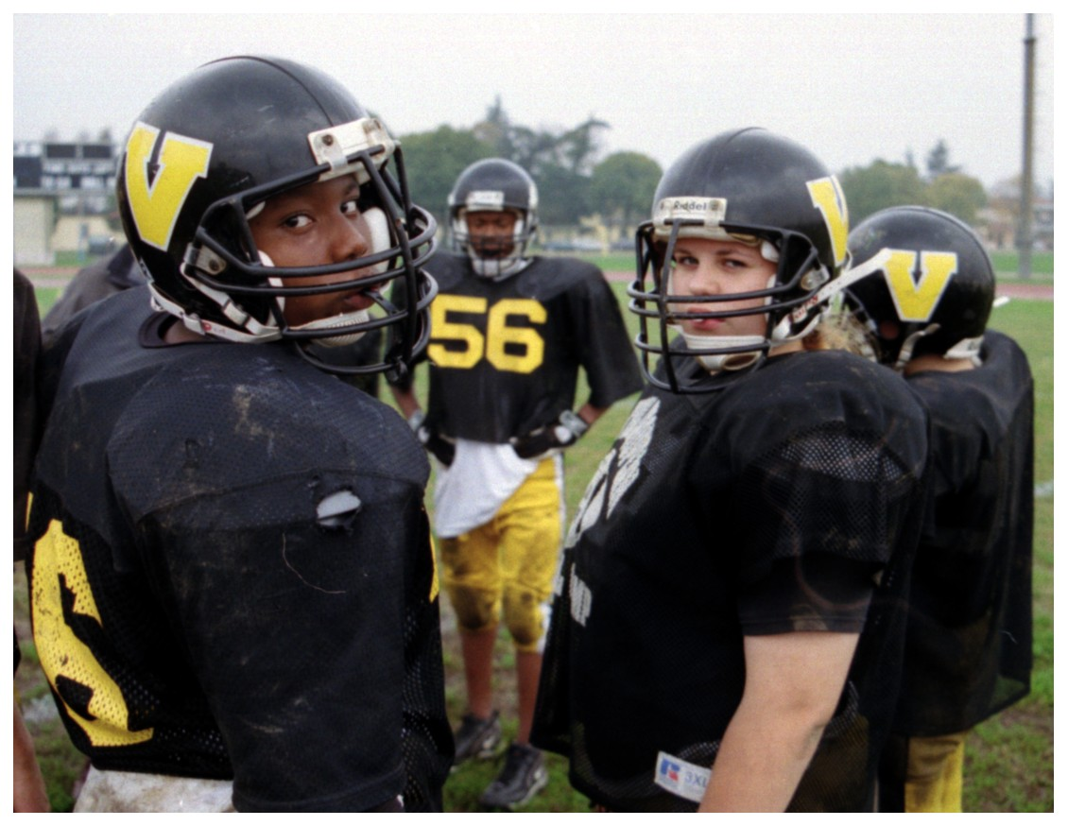
Secular education

Slide 12
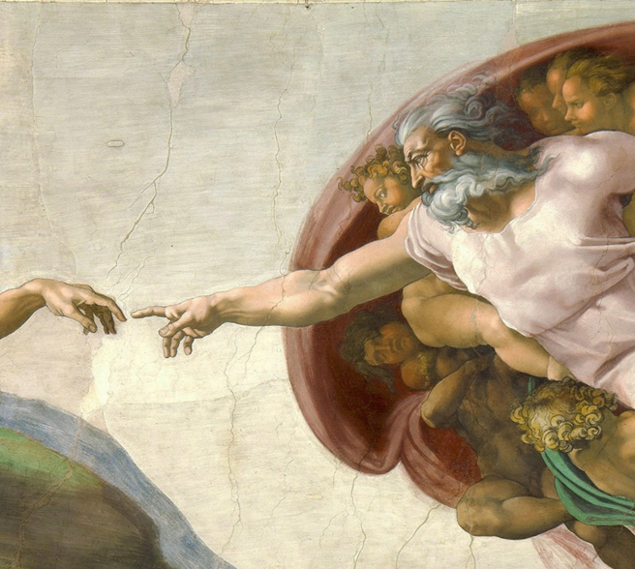
Catholic education

Slide 13
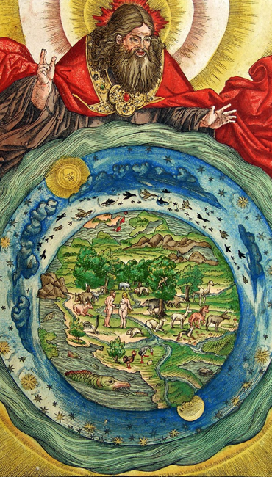
Cultivating the mind
define disciplines and relationships
begin with human dignity and nature
teach first principles
ascend above information
argument, evidence, testimony
logos, ethos, pathos
all knowledge is in God

