Slide 1

Catholic Habits of Mind
Module 3
Thinking with Faith, Thinking Philosophically; and Seeking and Valuing the Transcendent.
Denise Donohue Ed.D.
V.P. for Educator Resources and Evaluation
The Cardinal Newman Society
Patrick Reilly, Founder and President
The Cardinal Newman Society

Slide 2
Seeking and Valuing the Transcendent
With Bishop Barron and Church Documents
Notes:
Bishop Barron recently gave a talk at the University of Notre Dame on the Nature of a Catholic University. What he had to say about its nature is, I believe, also applicable to that of a Catholic K-12 school. The main point of his talk was that Catholic education should hold Christ as the central integrating and organizing principle. We are much more aware of this at the K-12 level, I think, than in higher education where all the academic departments are disparate and work using their own methodologies and particular principles. But this is exactly what Bishop Barron – and St. John Henry Newman –teach against. Both insist that theology should provide the central and organizing framework for the institution with Christ as the anchor. As a Catholic institution, this is only proper.
He went on to say that Theology doesn’t push aside the important academic work of these disciplines, but enlivens it as only the Spirit of Christ can do. Bishop Barron referred to a theological and philosophical premise of the non-competitive transcendence of God. He stated that theology isn’t the be-all, end-all moving all others aside.
He also spoke of how God is not a ‘being’, in the sense that he is not a genus; He is not one ‘thing’ among many. We are beings. Things are ‘beings.’ If God were a being, he would be in a competitive space since beings are all in a competitive relationship with each other. An example is, “I am me and you can’t be me.” You can’t take my space. God is not in a genus, not even a genus of being God. (Bishop Barron is taking all of this from the writings of St. Thomas Aquinas)
God is ipum esse. “To be” itself. Remember Moses, at the burning bush, asks God His name and God replies, “I Am, who AM” and sends Moses off to tell the Israelites “I AM” sent him.
When we bring our faith into the discussion of history, literature, science, music, mathematics, art, and all the disciplines, it enlivens it and makes it luminous and beautiful, like the face of St. Stephen that shone before his martyrdom. It allows the depth-dimension to be celebrated and explored. This non-competitive transcendence of God actually sustains all things and once allowed its pride of place in discussion and learning, brings out deeper richer moments for reflection, wonder, and the wallowing in the interconnectedness of things. Theology has a non-competitive transcendent relationship with other disciplines that can bring us into the transcendence.

Slide 3
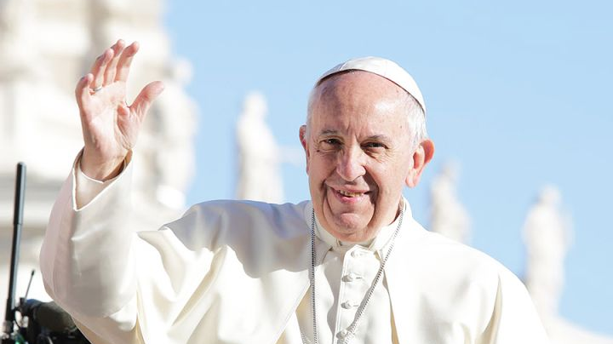
“For me the greatest crisis of education…is being closed to transcendence”
Notes:
Pope Francis has noted that “For me, the greatest crisis of education, in the Christian perspective, is being closed to transcendence.”
In order to attain this transcendent dimension, instructional process and methodologies should not thwart the opportunity for students to go beyond the pragmatic, utilitarian, and material. Instructional methods should allow time for discussion of higher truths aligning with the topic at hand. “Is this ethical and moral?” ”Is it true or just?” Does it advance human freedom or restrict it?” “How does this make me feel as a human being?” Using a philosophical framework like St. Thomas did allows us to form the whole person in body, mind, and spirit.

Slide 4


Applying Catholic Habits of Mind in the Classroom
Notes:
We must be purposeful and intentional in the formation of these approaches in order to assist students in developing the habits of thinking philosophically, with faith, and valuing and seeking the transcendent. To seek the transcendent is to keep Christ at the center of each discipline allowing our faith to have access to our thoughts on a subject. This can be facilitated with the use of philosophical reasoning and questioning that looks to the deeper meaning of things, such as what is the meaning of life, is to be “good” essential, what is the truth of this thing under study?
Let’s look to some generic standards commonly found in most schools and see how we can facilitate Catholic habits of mind in our students through an application of what we have just learned.

Slide 5
Peppe the Lamplighter
4th grade English Standard – Key ideas and Details: Explain how an author uses reasons and evidence to support particular points in a text.
Basic coverage of content:
The student will identify and explain how the author of Peppe the Lamplighter uses evidence and reasons to show how a person’s attitude toward something affects their behavior toward it. (Author’s Point)
Evidence #1: Peppe’s attitude to the work he had was at first appreciative and joyful.
Reason: Because through his job he could contribute to his family’s needs.
Evidence #2: Peppe’s attitude becomes despondent.
Reason: Because his father looked down on his work of lighting lamps and told him so in words and actions many times. “You’ll belong to the streets!” “You’ll never amount to anything!”

Slide 6
Sample English Standard and application of Catholic Habits of Mind:
4th grade English – Key ideas and Details: Explain how an author uses reasons and evidence to support particular points in a text.
A basic and perfunctory standard can be elevated through the choice of:
content rich materials (that satisfy the standard and student learning objectives and go beyond!);
inclusion of faith-based topics (allowing theology its pride of place);
use of philosophical questions; and
the keeping of Christ as the anchor who illumines and guides the discussion with deeper meaning – transcendence!
Notes:
Content Rich materials are more than anthology selections that skim the surface of most texts to highlight concepts, quickly flitting from literary definitions to genre. Include some selections that have artistic weight and enduring values, with multiple content-rich themes, and that trigger the moral imagination. (See the Newman Society’s “A Guide for the Catholic Reader”).
Include comparisons to stories about the faith. Jesus taught with metaphor. We can bring in these stories and teachings from our faith in an organic way. This allows for transference between learning and life. (HORIZONTAL).
Use philosophical questions. These are much like Essential Questions. They are questions that require deep thinking about multiple aspects of a topic and often don’t have pat answers. They usually involve topics about human nature –such as “why is freedom necessary?”, “what does it mean to love?”; the origins of the universe, morality, and culture. In your handouts you will see how we use the philosophical questions of Truth, Beauty, and Goodness in our Transcendental Taxonomy as springboards for discussion.
All the while, we need to allow room for application of the content to our own personal faith development and ask questions such as ”What does this mean to me and my relationship to God?” “How does this build me us as a follower of Christ?” These should be common questions in our schools.

Slide 7
Sample 4th Grade English Standard with Catholic Habits of Mind
4th grade English – Key ideas and Details: Explain how an author uses reasons and evidence to support particular points in a text.
The student will identify and explain how the author of Peppe the Lamplighter uses evidence and reasons to show how a person’s attitude toward something affects their behavior toward it.
Evidence #1: Peppe’s attitude to the work he had was at first appreciative and joyful.
Reason: Because through his job he could contribute to his family’s needs.
Evidence #2: Peppe’s attitude becomes despondent.
Reason: Because his father looked down on his work of lighting lamps and told him so in words and actions many times. “You’ll belong to the streets!” “You’ll never amount to anything!”
Notes:
We have already satisfied the requirements of the standard in our first example. And we have already chosen a content-rich text. There are multiple themes running throughout Peppe the Lamplighter. The themes of family relationships, hardships for immigrants, the importance of community, the authority and duties of parents and children, how what we do affects others, how body language tells something about how we feel and think, how we can give a gift or ourself to others, love, how our attitude effects our work, and how through suffering and obedience darkness is turned into light – that’s all in this little book of 32 pages! Once identifying these themes, we can apply Church teachings to any one of them. With family relationships we can talk about love and how obedience to parents is important and a commandment from God. How our good and bad choices affect others. How we can give ourselves as a gift to others in very simple ways. How the use of words (both good words and bad) can hinder or help. How work allows us to join with God in caring for His creation and how to respect and honor others.
Adding an overarching philosophical question to this discussion such as” is work important for humanity?” can bring us into deeper discussion topics such as “what is work?”; “What would man do if he couldn’t work? How would he feel? What would his attitude be toward those who do work? These questions hit home for students because they are applicable to them. These questions help form a Christian morality in students. A transcendental that could be applied here is goodness as a fulfillment of a thing. The lamps were made to be lit and didn’t do their job when they weren’t. A good son is one who is obedient and cares for his family.
The wonderful example of Peppe, who while lighting each lamp, offers prayers to God for members of his family. This is a wonderful example of teaching students to offer their daily work to God; to let our whole lives be one of prayer to Him. Implementing the Catholic Habits of Mind of thinking with faith through sensitizing the conscience, showing the compatibility of faith and reason and that faith is a valid way of knowing, using philosophical questions, and keeping Christ and Church teaching at the center of instruction moves students beyond merely satisfying the objective to satisfying the human heart and fostering human flourishing.

Slide 8
Sample Standards
K Standard Social Studies: Individuals have many wants and needs and make decisions to satisfy those wants and needs. These decisions impact others.
6th Grade Geography: The variety of physical environments influences human activities. Likewise, human activities modify the physical environment.
11th grade US History: Examine the influences of George Washington’s presidency in the formation of the new nation.
Content rich material
Thinking with faith - Christocentric
Thinking philosophically – taxonomy of questioning; integration of disciplines
Seeking and Valuing the Transcendent – God’s bigger plan

Slide 9


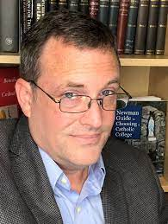
Thank you!
Promoting and defending faithful Catholic education
Denise Donohue, ed.d. ddonohue@cardinalnewmansociety.org
Patrick Reilly preilly@cardinalnewmansociety.org
Notes:
This presentation was originally given at NCEA 2023 in Irving, TX.

